Slide 1
Medium-Sized Switched Network Construction
Improving Performance with Spanning Tree

Slide 2
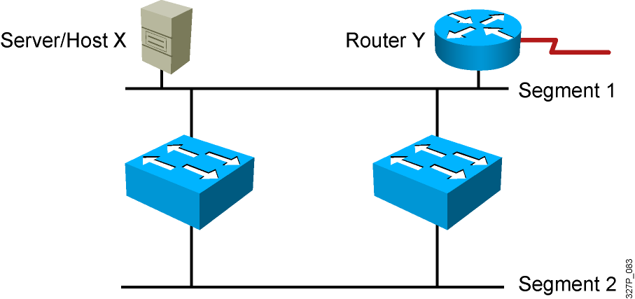
Redundant Topology
Redundant topology eliminates single points of failure.
Redundant topology causes broadcast storms, multiple frame copies, and MAC address table instability problems.
Notes:
Emphasize: Layer 2 has no mechanism (like a TTL) to stop loops.

Slide 3
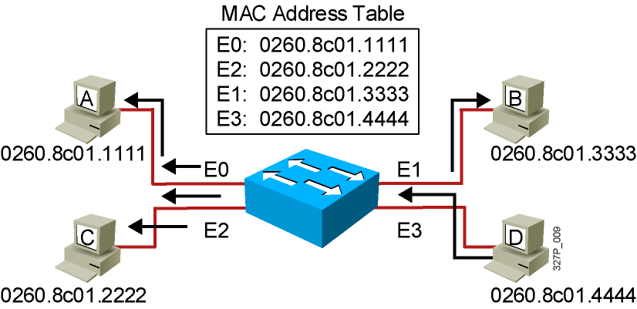
Broadcast Frames
Station D sends a broadcast frame.
Broadcast frames are flooded to all ports except the originating port.

Slide 4
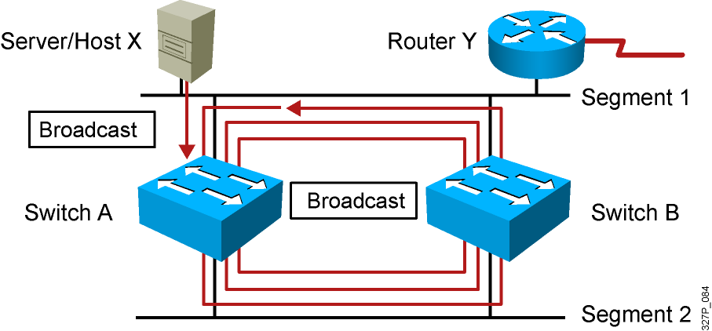
Broadcast Storms
Host X sends a broadcast.
Switches continue to propagate broadcast traffic over and over.
Notes:
Layer 3 of 3
Emphasize: Layer 2 has no TTL mechanism to stop looping frames.

Slide 5
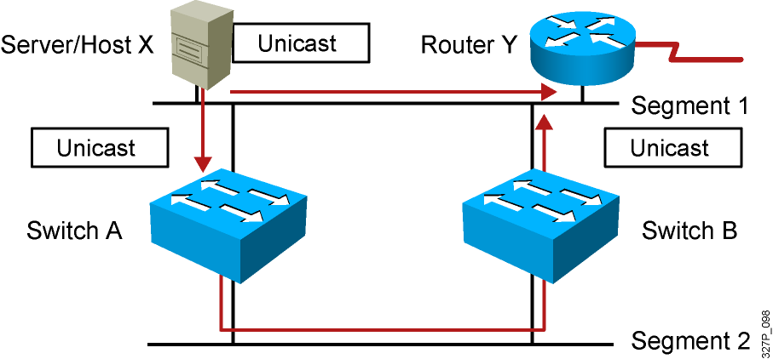
Multiple Frame Copies
Host X sends a unicast frame to router Y.
The MAC address of router Y has not been learned by either switch.
Router Y will receive two copies of the same frame.
Notes:
Layer 2 of 2

Slide 6
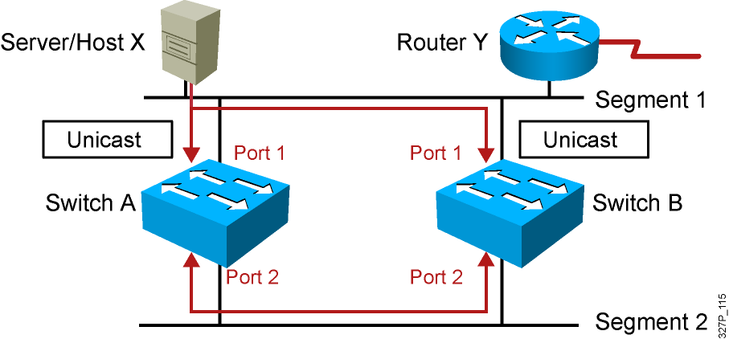
MAC Database Instability
Host X sends a unicast frame to router Y.
The MAC address of router Y has not been learned by either switch.
Switches A and B learn the MAC address of host X on port 1.
The frame to router Y is flooded.
Switches A and B incorrectly learn the MAC address of host X on port 2.
Notes:
Layer 2 of 2

Slide 7
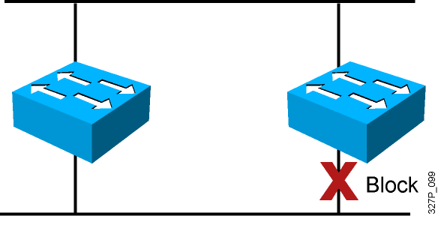
Loop Resolution with STP
Provides a loop-free redundant network topology by placing certain ports in the blocking state
Published in the IEEE 802.1D specification
Enhanced with the Cisco PVST+ implementation
Notes:
Emphasize: A looped topology is often desired to provide redundancy, but looped traffic is undesirable. The Spanning-Tree protocol was originally designed for bridges. Today, it is also applied to LAN switches and routers operating as a bridge. Spanning-Tree protocol ensures that all bridged segments are reachable but any points where loops occur will be blocked.

Slide 8
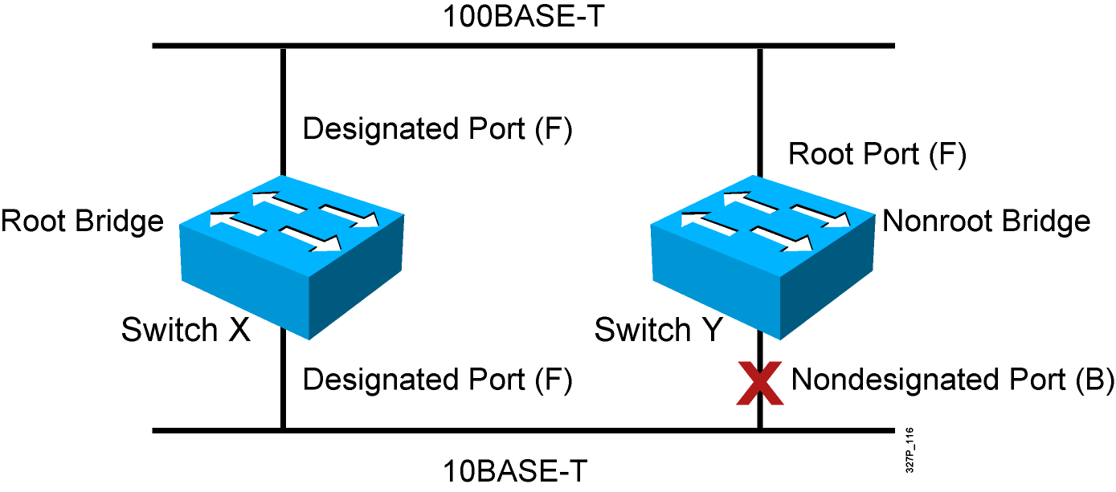
Spanning-Tree Operation
One root bridge per broadcast domain.
One root port per non-root bridge.
One designated port per segment.
Non-designated ports are unused.
Notes:
Emphasize: The three general rules when dealing with STP are as follows:
1. One root bridge per network. The root is the bridge with the lowest bridge ID. All the ports on the root bridge are designated ports (forwarding).
2. For every non-root bridge, there is a root port (forwarding). The root port is the port with the lowest accumulated path cost to the root bridge.
3. For every segment, there is only one designated port. The designated port forwards traffic for the segment. The designated port has the lowest accumulated path cost to the root bridge.

Slide 9
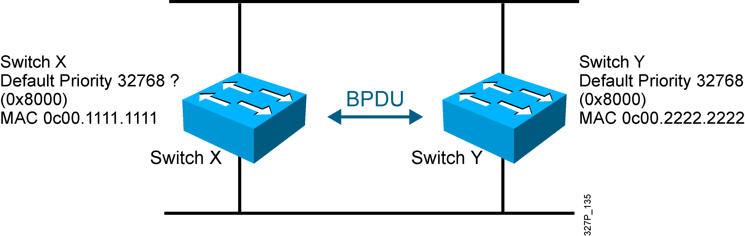
STP Root Bridge Selection
BPDU (default = sent every 2 seconds)
Root bridge = bridge with the lowest bridge ID
Bridge ID =
Bridge
Priority
MAC
Address
Notes:
Emphasize: By default, the switch with the lowest MAC address will be the root bridge.
Note: The Catalyst switches support an instance of spanning tree per VLAN. Each VLAN will use a unique MAC address for spanning tree purposes. On the Catalyst 1900, the address it uses for spanning tree is the MAC address on the various ports. VLAN is discussed in the next chapter.
The IEEE 802.1d specification specifies for a 16-bit priority field. The Catalyst 1900 switch only supports the 802.1d Spanning-Tree protocol. The default priority on the Catalyst 1900 is 32768 in decimal or 8000 in hex, the midrange value.
BPDU contain the following fields:
Protocol ID version
Message type
Flags
Root ID
Cost of path
Bridge ID
Port ID
Message age
Max age
Hello time
Forward delay

Slide 10
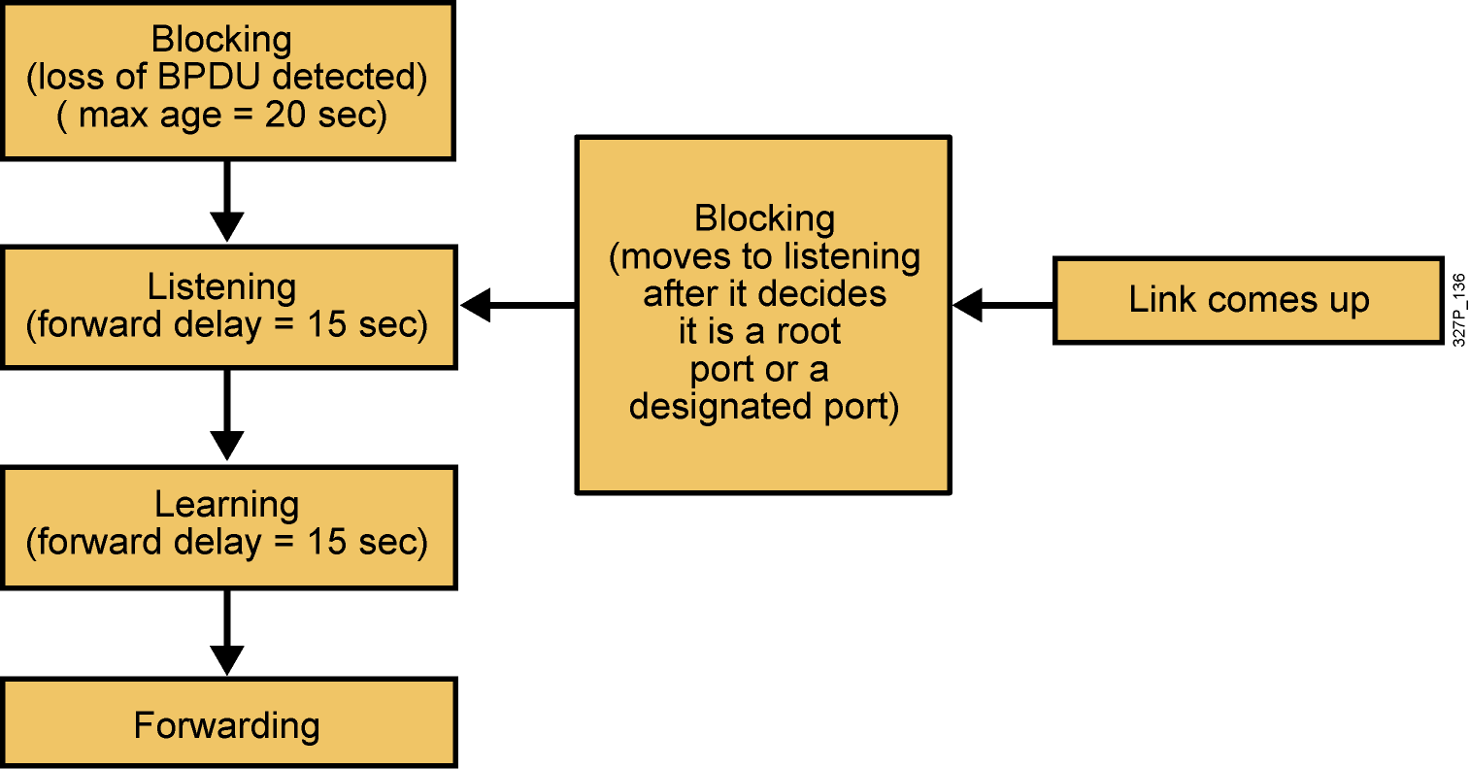
Spanning-Tree Port States
Spanning tree transits each port through several different states:
Notes:
Emphasize: Using the default Spanning-Tree protocol timers setting, the times it takes to go from the blocking state to the forwarding state is 50 sec (20 + 15 + 15).

Slide 11
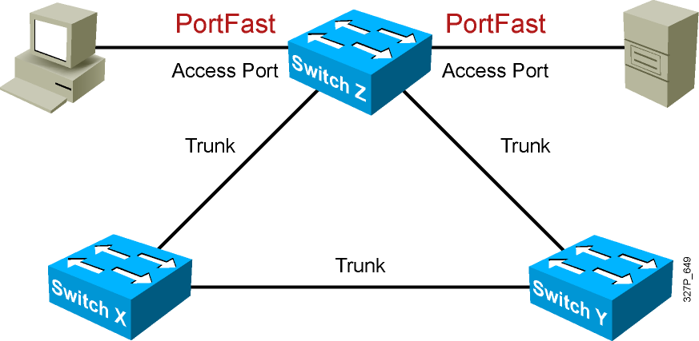
Describing PortFast
PortFast is configured on access ports, not trunk ports.

Slide 12
Configuring and Verifying PortFast
SwitchX(config-if)# spanning-tree portfast
Configures PortFast on an interface
OR
SwitchX(config)# spanning-tree portfast default
Enables PortFast on all non-trunking interfaces
SwitchX# show running-config interface interface
Verifies that PortFast has been configured on an interface

Slide 13
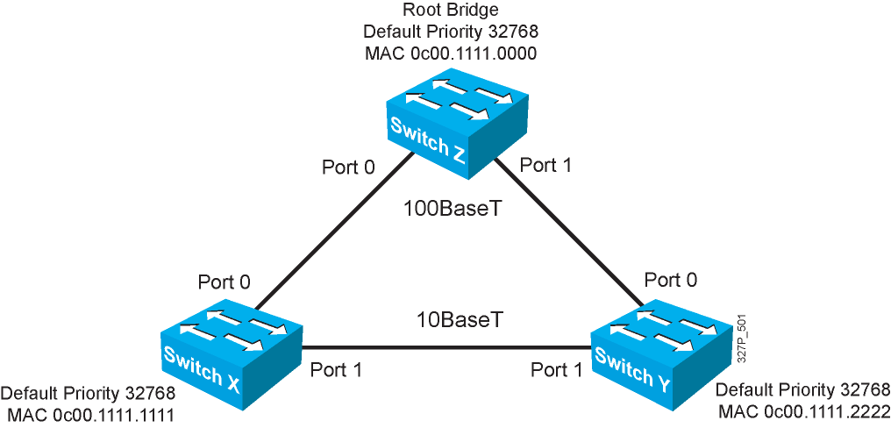
Spanning-Tree Operation Example
Notes:
Layer 2 of 2
Emphasize: Switch X and Y have the same path cost to the root bridge. The DP for the bottom segment is on switch X because switch X has a lower bridge ID than switch Y.

Slide 14
Spanning-Tree Path Cost
Link Speed | Cost (Revised IEEE Specification) | Cost (Previous IEEE Specification)
10 Gb/s | 2 | 1
1 Gb/s | 4 | 1
100 Mb/s | 19 | 10
10 Mb/s | 100 | 100
Notes:
Emphasize: There are two cost calculation methods. The Catalyst 1900 uses the older method. The new method is designed to accommodate the higher gigabit Ethernet speed.
Note:
Port priority is used to determine which path has preference when path costs are equal (for example, when you have two parallel links connecting two switches together). The default port priority is 128.
The port aggregation protocol and EtherChannels® are not taught in this class.
Fast EtherChannel is supported by the Catalyst 1900 switch.

Slide 15
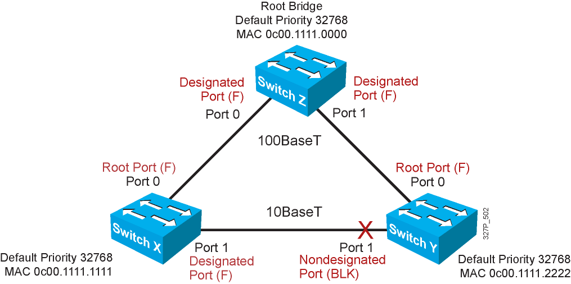
Spanning-Tree Recalculation
Notes:
Emphasize: RPs and DPs are normally in the forwarding state.
There is only one DP per segment.

Slide 16
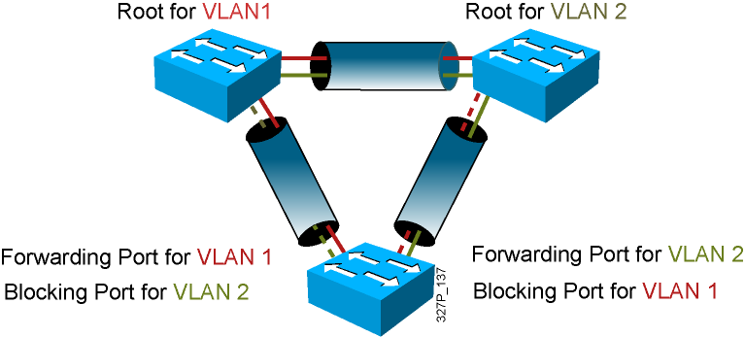
Per VLAN Spanning Tree Plus

Slide 17
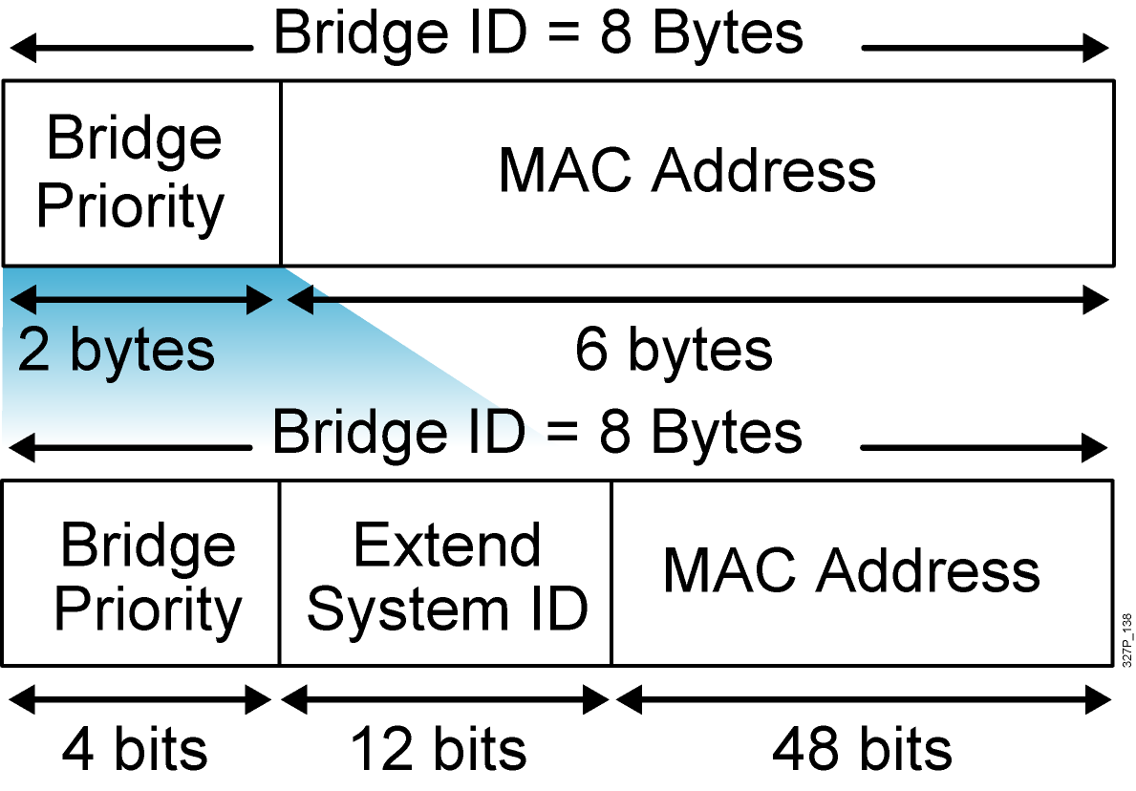
PVST+ Extended Bridge ID
Bridge ID without the
extended system ID
Extended bridge ID
with system ID
System ID = VLAN

Slide 18
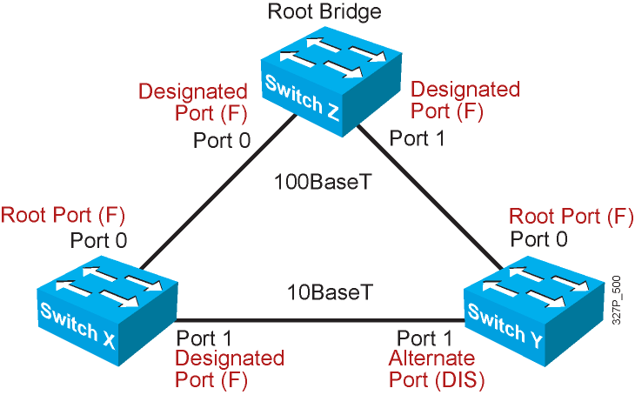
Rapid Spanning Tree Protocol

Slide 19
Default Spanning-Tree Configuration
  Cisco Catalyst switches support three types of STPs:
    PVST+
    PVRST+
    MSTP
  The default STP for Cisco Catalyst switches is PVST+:
    A separate STP instance for each VLAN
    One root bridge for all VLANs
    No load sharing

Slide 20
PVRST+ Configuration Guidelines
Enable PVRST+.
Designate and configure a switch to be the root bridge.
Designate and configure a switch to be the secondary
root bridge.
Verify the configuration.

Slide 21
PVRST+ Implementation Commands
SwitchX(config)# spanning-tree mode rapid-pvst
Configures PVRST+
SwitchX# show spanning-tree vlan vlan# [detail]
Verifies the spanning-tree configuration
SwitchX# debug spanning-tree pvst+
Displays PVST+ event debug messages

Slide 22
Verifying PVRST+
SwitchX# show spanning-tree vlan 30
VLAN0030
Spanning tree enabled protocol rstp
Root ID Priority 24606
Address 00d0.047b.2800
This bridge is the root
Hello Time 2 sec Max Age 20 sec Forward Delay 15 sec
Bridge ID Priority 24606 (priority 24576 sys-id-ext 30)
Address 00d0.047b.2800
Hello Time 2 sec Max Age 20 sec Forward Delay 15 sec
Aging Time 300
Interface Role Sts Cost Prio.Nbr Type
-------- ----- --- --- -------- ----
Gi1/1 Desg FWD 4 128.1 P2p
Gi1/2 Desg FWD 4 128.2 P2p
Gi5/1 Desg FWD 4 128.257 P2p
The spanning-tree mode is set to PVRST.

Slide 23
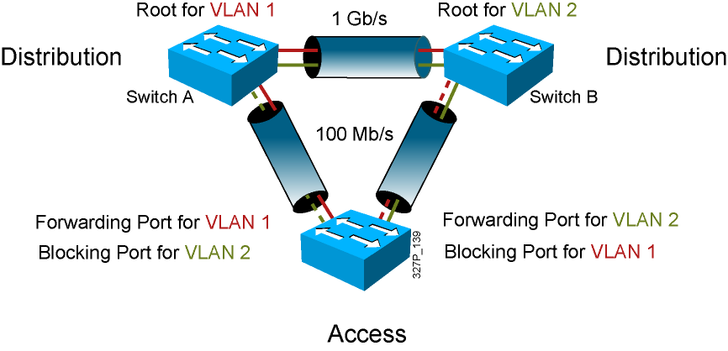
Configuring the Root and
Secondary Bridges

Slide 24
Configuring the Root and
Secondary Bridges: SwitchA
SwitchA(config)# spanning-tree vlan 1 root primary
This command forces this switch to be the root for VLAN 1.
SwitchA(config)# spanning-tree vlan 2 root secondary
This command configures this switch to be the secondary root for VLAN 2.
OR
SwitchA(config)# spanning-tree vlan # priority priority
This command statically configures the priority (increments of 4096).

Slide 25
Configuring the Root and
Secondary Bridges: SwitchB
SwitchB(config)# spanning-tree vlan 2 root primary
This command forces this switch to be the root for VLAN 2.
SwitchB(config)# spanning-tree vlan 1 root secondary
This command configures this switch to be the secondary root for VLAN 1.
OR
SwitchB(config)# spanning-tree vlan # priority priority
This command statically configures the priority (increments of 4096).

